Slide 1
Team 3
Preprocessing Data for Lung Disease
Team Members:
Prashant Ram
Muhammad Hassan
Mohamed Burhan
Gandhar Tare

Slide 2
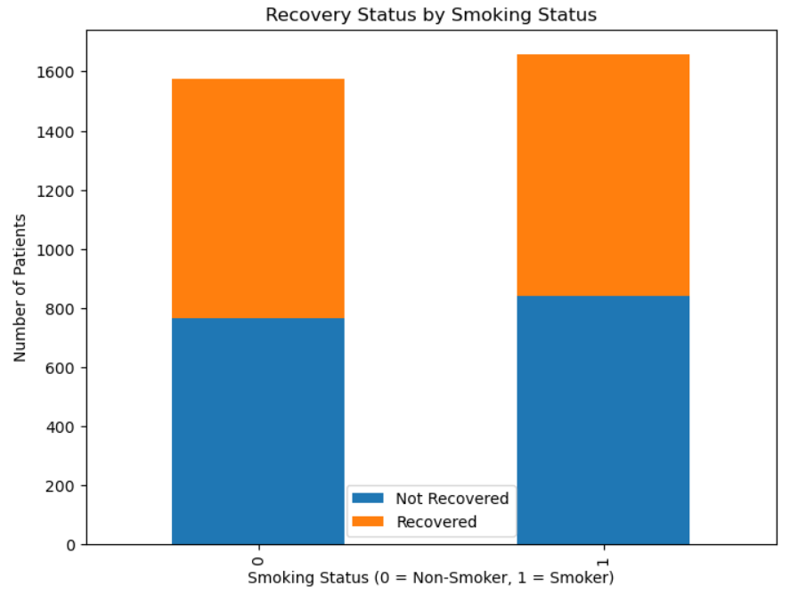
Recovery Status Against their Smoking Status
Interpretation
The stacked bar graph depicts that patients who were Non-smokers had about similar recovery outcomes as the ones who smoked. However, we can clearly see that Smokers had a higher outcome of not recovering from their lung diseases.
Insight
The insight that we can make from this is that smoking can worsen the recovery outcome of lung diseases.

Slide 3
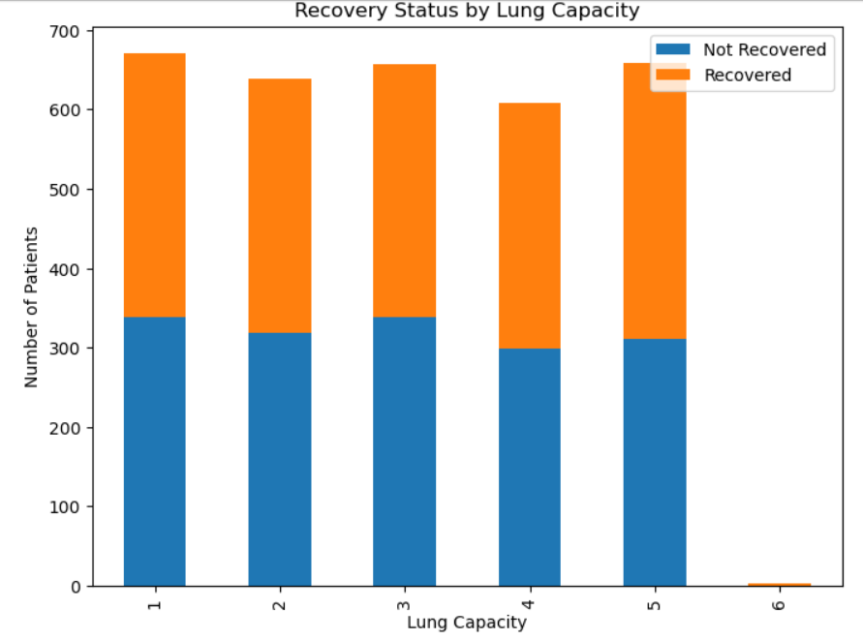
Recovery of Patient Against Their Lung Capacity
Interpretation
The stacked bar graph depicts that patients who had a lower lung capacity (1, 2 and 3) had higher "Not recovered" count. Moreover, patients with a high lung capacity (4-5) had about similar ratio of Recovered and Not Recovered. Finally, patients with the highest lung capacity of 6 had always recovered.
Insight
The insight that we can make from this is that a lower lung capacity can significantly reduce the recovery outcomes whereas a very high one can almost always guarantee recovery.

Slide 4
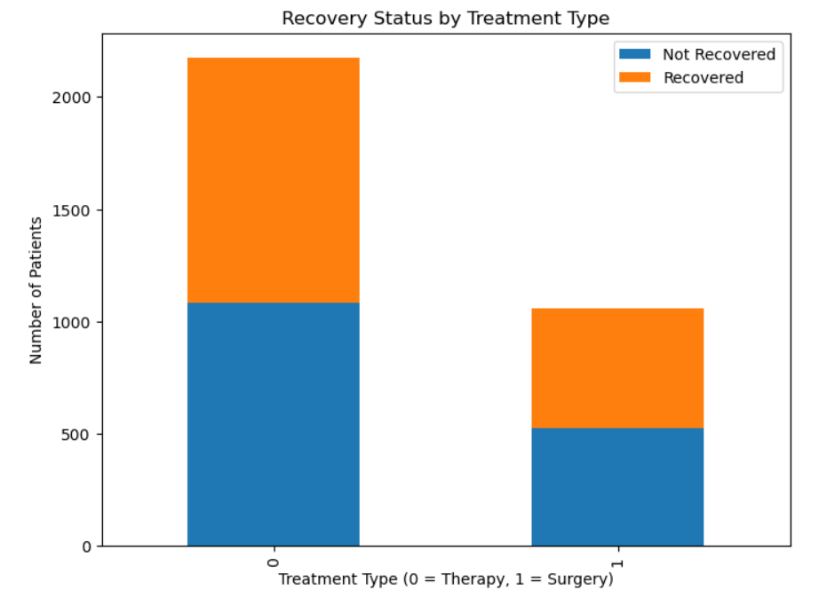
Recovery of Patient Against Their Treatment Types
Interpretation
We can see that patients which opted for therapy as their form of treatment had a higher count of not recovering when compared to the ones who chose surgery. The ones who chose surgery had a higher count of recovering after the treatment.
Insight
We can say that surgical forms of treatment work much better than just therapeutical kind.

Slide 5
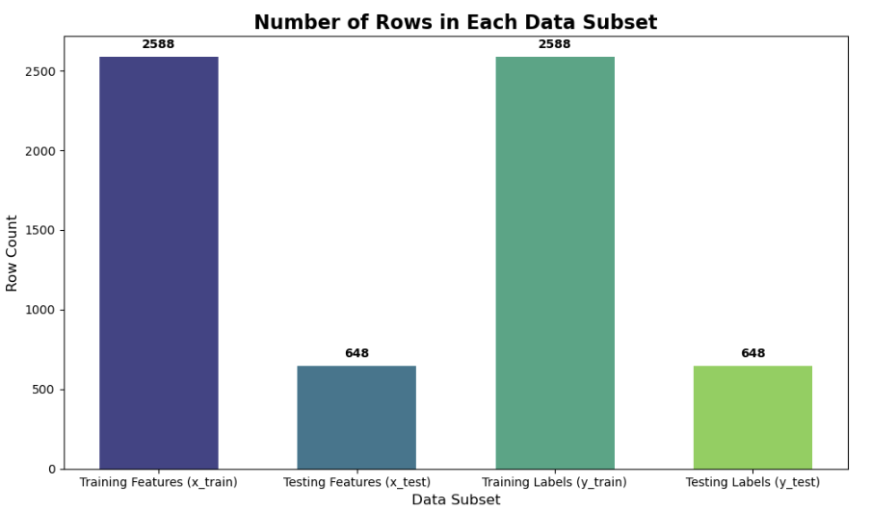
Data Subset Overview & Target Distribution
What It Shows:
This bar chart presents the number of samples in each data subset from our 80/20 train/test split.
It includes “Training Features (x_train)”, “Testing Features (x_test)”, “Training Labels (y_train)”, and “Testing Labels (y_test)”.
Interpretation:
The chart confirms that approximately 80% of the samples are in the training set and 20% in the testing set. The exact counts, annotated on each bar, ensure we have a clear, balanced split.
Machine Analysis Insight:
Automated splitting methods were used to ensure that our data distribution remains consistent, which is crucial for building reliable predictive models.

Slide 6
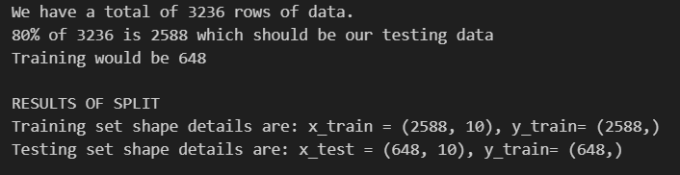
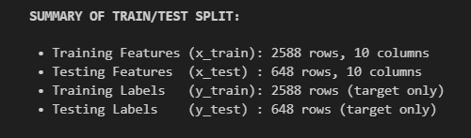
Data split
Details
For the training dataset, we excluded the “Gender” column because it was irrelevant for our training model.
We chose our target variable as the “Recovered” column because we wanted to see if the patient had recovered or not through various treatments while afflicted with different types of lung disease.
Finally, we shuffled the data before splitting to avoid any bias by mixing any ordering of data. The split accurately split our dataset into the models and displayed the results of what we wanted to see.

Slide 7
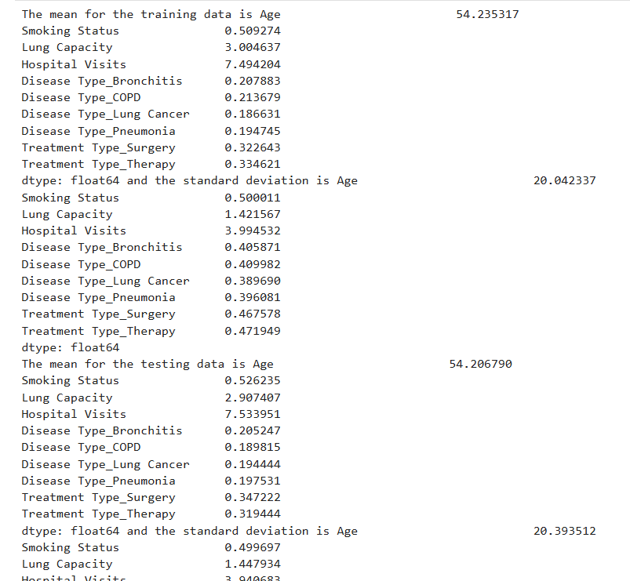




Comparing the train and test model Results
Details
We then calculated the mean and standard deviation for both the training and the test data to see if they matched. The results showed that they were extremely close, which meant that the split of the two datasets was representative and consistent.

